Slide 1
Robbinsdale 2040
City of Robbinsdale’s 2040 Comprehensive Plan

Slide 2
Comprehensive Plan Steps
Staff began working on the new Plan in February of 2017.
Three Open Houses were held in 2017 with the Planning Commission (April, July, October),
A required Public Hearing with the Planning Commission will be held on Thursday, February 15th – 7 pm.
The Plan will be submitted to adjacent communities for review in March/April where they will have 6 months to review the plan and provide comments.
Council must authorize the submission of the Plan to the Met Council by Resolution before December 31, 2018.

Slide 3
Components of the Comprehensive Plan
Land Use
Parks, Recreation, Trail and Open Space
Housing
Economic Competitiveness
Transportation
Resilience
Water Resources and other infrastructure
Implementation

Slide 4
Land Use
Community Role
Different Categories of Land Use
Future Land Use
Future Population Projections
Transportation Analysis Zones

Slide 5
Robbinsdale is designated as an “Urban Center”
Robbinsdale’s location relative to the metro area has caused the Metropolitan Council to designate it as an “Urban Center.” This designation carries expectations for overall densities relative to the forecasts.

Slide 6
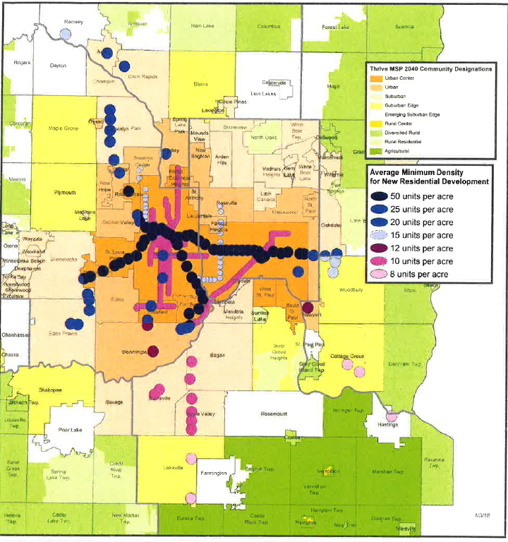
TPP Density Policy for Transit

Slide 7
Forecasted Population, Households and Employment

Slide 8
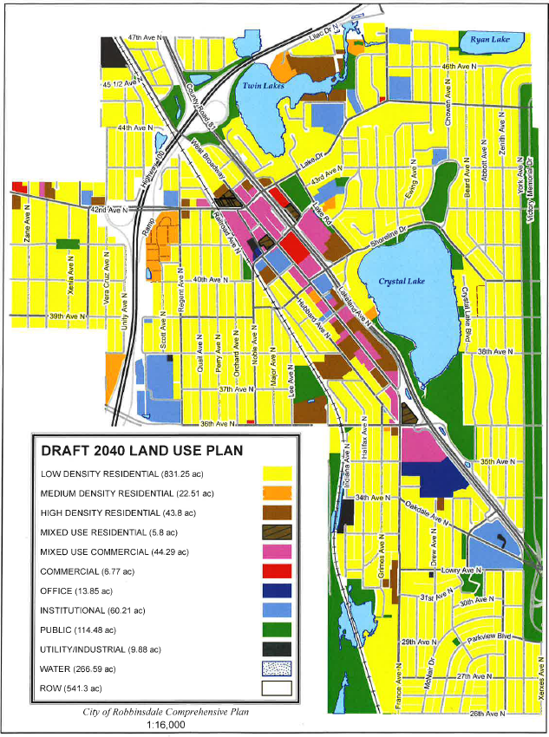
2040 Land Use Map

Slide 9
Potential Redevelopment Sites

Slide 10
Housing
Density Analysis
Types of Housing
Single Family
Single Family Attached
Multi-Family
Naturally Occurring Affordable Housing
Required Allotment of Affordable Housing
Scattered Site Redevelopment

Slide 11
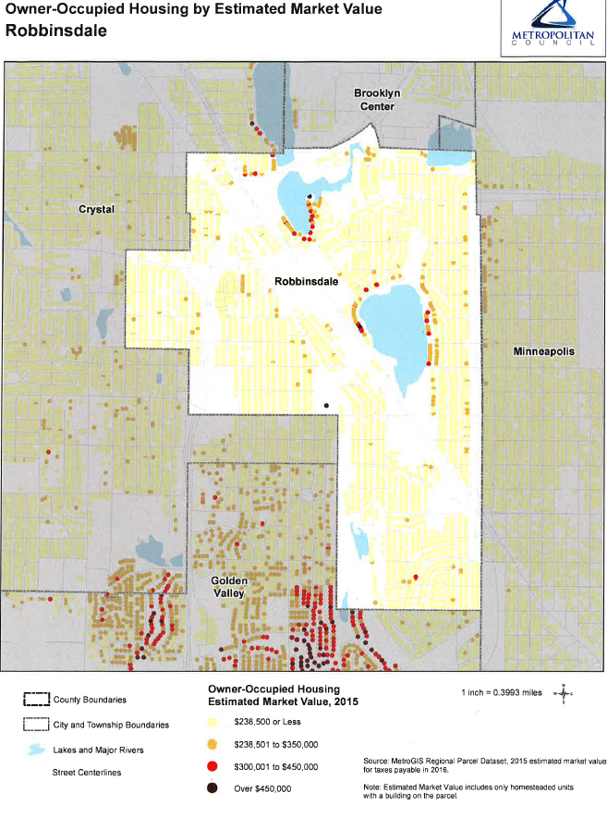
Owner-Occupied Housing by Estimated Market Value in Robbinsdale

Slide 12
Transportation
Transportation Analysis Zones
Blue Line Extension and Public Transit
Roads and Streets
Aviation and Freight
Bicycling and Walking
Complete Streets Policy

Slide 13
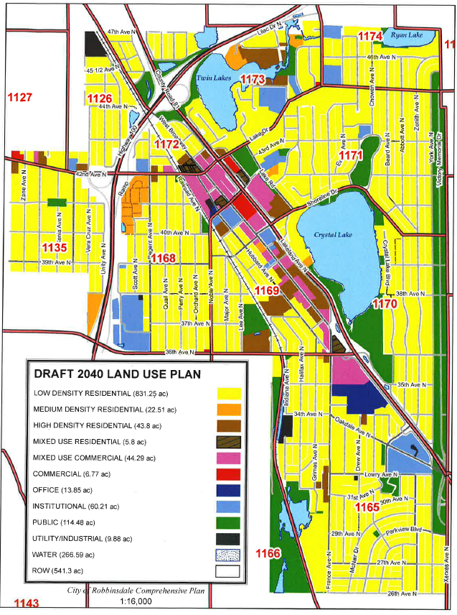
Transportation Analysis Zones and Land Use

Slide 14
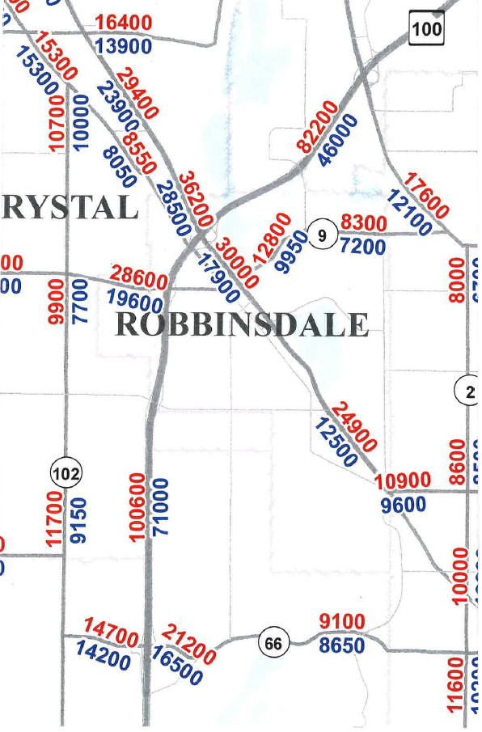
County and State Road Traffic Counts

Slide 15
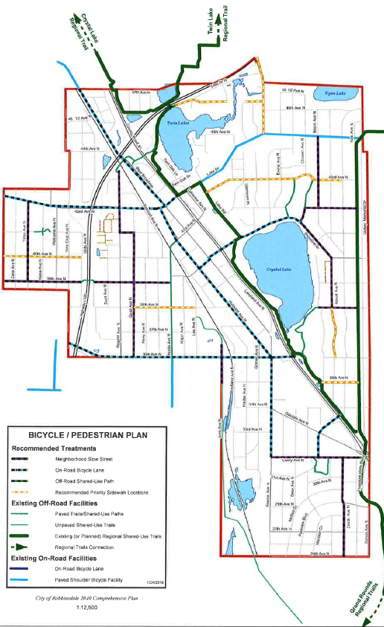
Bicycle and Pedestrian Map

Slide 16
Economic Competiveness
Key Industries/Centers of Employment
Downtown Robbinsdale
Major Employers
Potential Redevelopment Sites
Education and Workforce
Affordable Housing
Attracting, Growing and Retaining Businesses

Slide 17
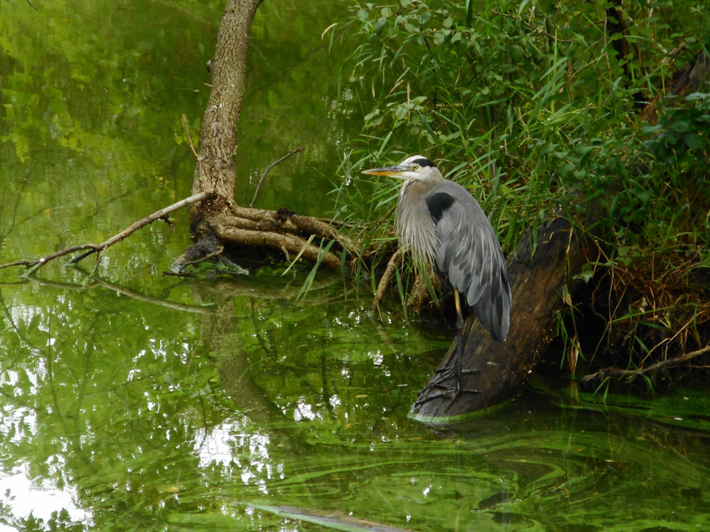
Public Facilities and Water Resources
Water Supply System
Sanitary Sewer System
Storm Water System
Solid Waste Program

Slide 18
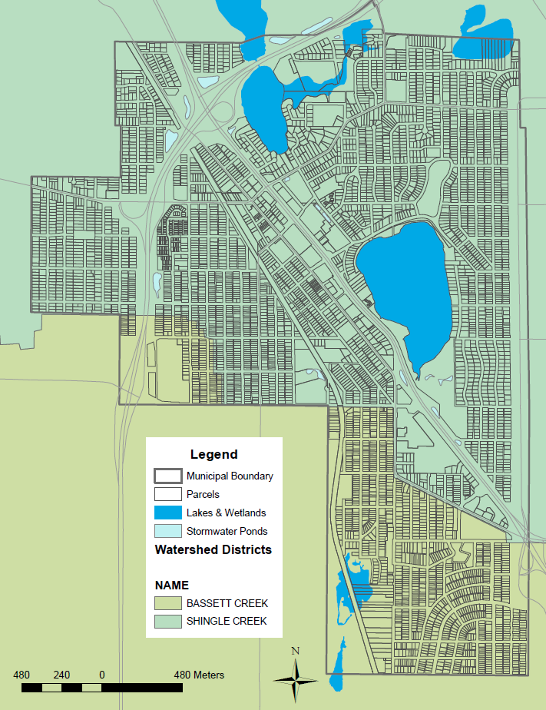
Surface Water Watershed Districts

Slide 19
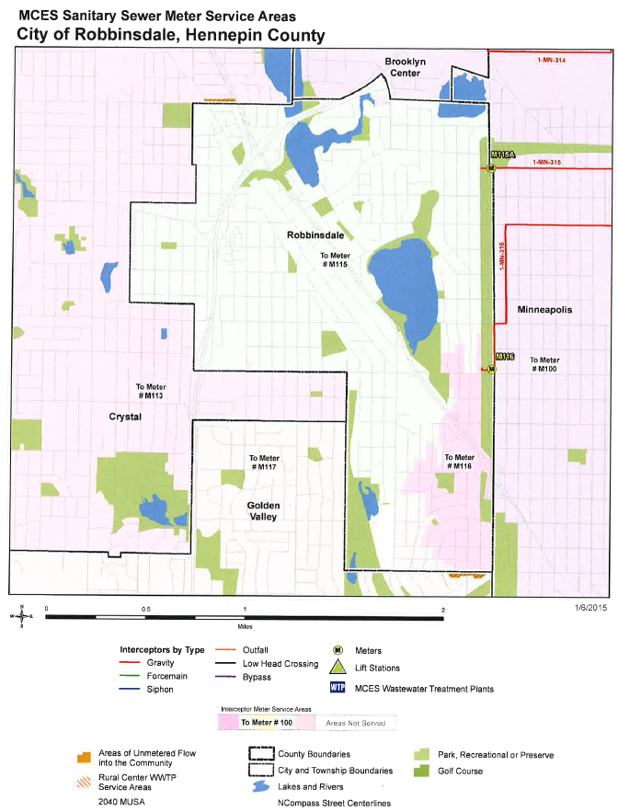
Sanitary Sewer Map

Slide 20
Resilience
Healthy Communities
Historical Preservation
Instructure & Environment
Forestry
Protecting Solar Resources

Slide 21
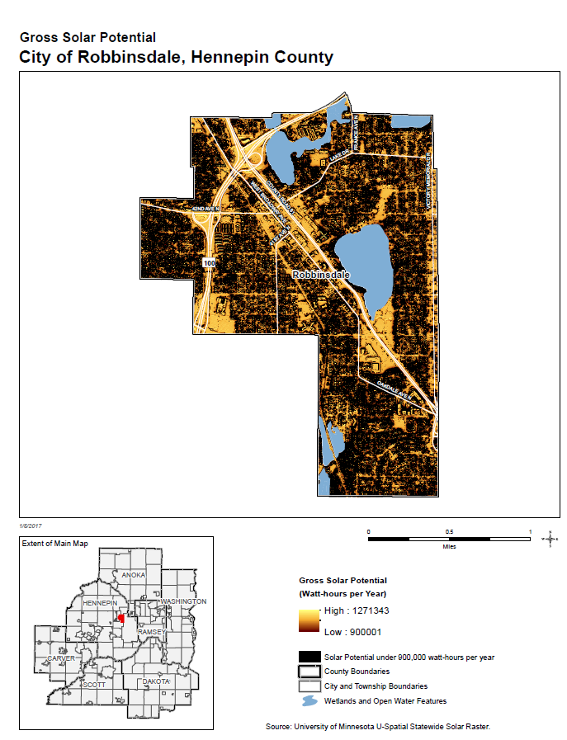
Robbinsdale Gross Solar Potential

Slide 22
Parks and Trails
Regional Parks and Trails
Crystal Lake Regional Trail
Twin Lake Regional Trail
Victory Memorial Parkway
Local Parks and Trails
14 parks
108 acres of park land
Recreation Programs
Parks Capital Improvement Plan 2018-2022

Slide 23
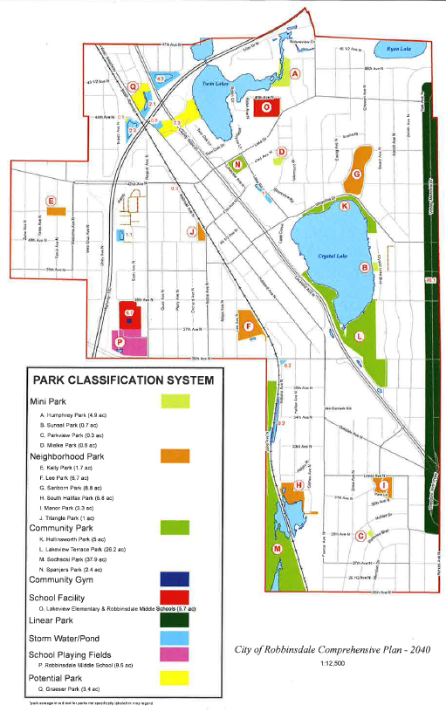
Park Classification System

Slide 24
Bicycle and Pedestrian Map

Slide 25
Questions?

