Slide 1
2040 Comprehensive Plan Open House
City of Robbinsdale, Minnesota

Slide 2
Where do you see Robbinsdale in the year 2040?

Slide 3
Components of the Comprehensive Plan
Land Use
Parks, Recreation, Trail and Open Space
Housing
Economic Competitiveness
Transportation
Resilience
Water Resources and other infrastructure
Implementation

Slide 4
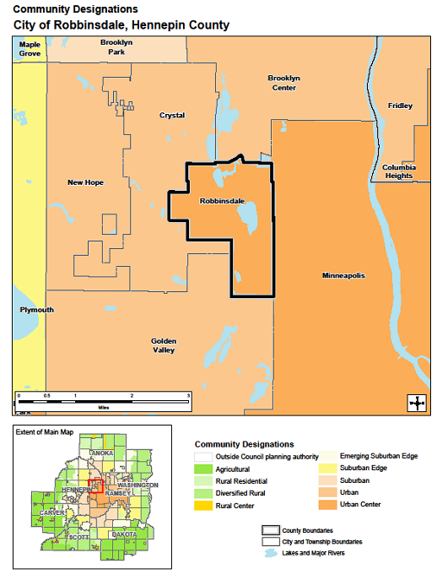
Robbinsdale is designated as an “Urban Center”.
Robbinsdale’s location relative to the metro area has caused the Metropolitan Council to designate it as an “Urban Center.” This designation carries expectations for overall densities relative to the forecasts.

Slide 5
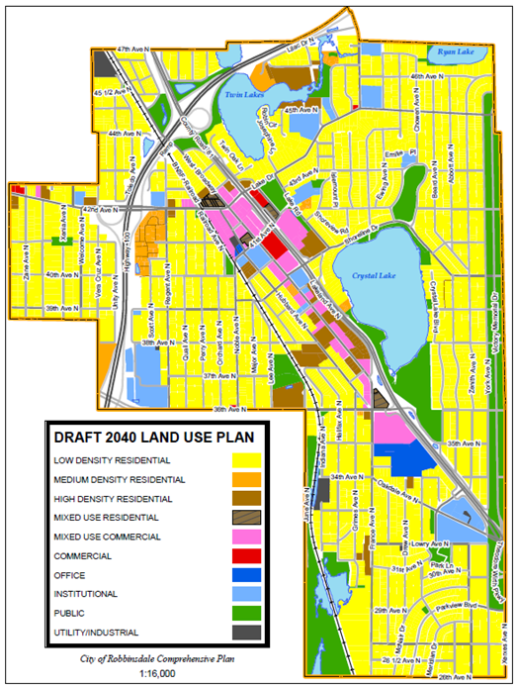

Slide 6
Forecasted Population, Households and Employment by the Metropolitan Council
Forecast Year | Population | Households | Employment
2010 (Census) | 13,953 | 6,032 | 6,858
2020 | 14,750 | 6,300 | 7,000
2030 | 15,100 | 6,600 | 7,100
2040 | 15,300 | 6,800 | 7,200
Forecast Year & Projected Growth | Population | Households | Employment
2010 (Census) | 13,953 | 6,032 | 6,858
April 1, 2015 (Met Council est.) | 14,757 | 6,209 | N/A
2020 (2017-2020) | 14,750 -7* | 6,300 +90 | 7,000 +142
2030 | 15,100 +350 | 6,600 +300 | 7,100 +100
2040 | 15,300 +200 | 6,800 +200 | 7,200 +100
* Estimates only
Minimum community wide densities established in Thrive MSP 2040 | 20 units per acre
Density expectations for fixed or dedicated rights-of-way transitway station area (area within 10-minute walk or ½ mile area) | Minimum 50 units per acre Target: 75-150+ units per acre

Slide 7
The Comprehensive Plan is intended to identify policies that guide the future development of land.
The following sites are being presented as possible locations for redevelopment.
No development related applications have been received and the affected property owners have ultimate discretion whether to sell their property for development, or to become a partner in a development.
In most cases, the examples are made up of multiple properties with multiple property owners that may be a challenge for anyone trying to assemble a site for a development project.
With the regional growth projections in mind, the challenge is to imagine properties that may redevelop and accommodate the increase of population, households (and employment) that are identified for Robbinsdale by the Metropolitan Council.

Slide 8
Current Timeline of Light Rail Arrival
The Blue Line LRT Extension is set to begin passenger operations in 2022.
Engineering phase is nearly 90% complete.
Replacement of infrastructure and other public improvements will coincide with the project.

Slide 9
Development Process
Robbinsdale has been considered “fully developed” since the 1970s. Meaning any new development will result in the renovation or removal of the existing structure.
The owner or owners of a property get to decide how they use the land within the rules of zoning and city ordinances. The idea of zoning rules is to balance out the interests of the property owner, city and residents. The city's comprehensive plan lays out general land use rules that determine what types of developments can go where in the city. If the developer meets the conditions laid out in city ordinances, they will be able to build. The city can require the use of a property to conform to what is laid out within the comprehensive plan. In the case of the two proposed developments, both areas are zoned to allow mixed use development of the site proposed.
The 60-day rule states that municipalities have 60 days to approve or deny a written zoning request or it is otherwise deemed approved. To learn more about the 60 day rule, click on this document from the League of Minnesota Cities.

Slide 10
Development Architectural Design Guidelines
The Comp Plan update process provides an opportunity to develop policies to promote articulated development standards. Staff would then implement the policies with amendments to the zoning code which will specify the new development standards.
In the middle 1990’s a planning study produced the “Downtown Architectural Design Guidelines” which set the expectations for redevelopment projects in the downtown.
The Hy-Vee project and Birdtown Flats (still pending City Council review and action) generated public comment from people who would have expected that the principles of the downtown guidelines should have been applied to those projects. The apparent assumption being that the comp plan “mixed- use” land use designation should result in a specific pattern of development which emulates the traditional downtown character.
The Robbinsdale Economic Development Authority is discussing the idea of development performance standards as a requirement for developers requesting Tax Increment Financing assistance.

Slide 11
Development Architectural Design Guidelines (cont.)
Things to be considered:
Building Materials
Build-to lines
Parking
Building massing
Sustainability

Slide 12
Development Architectural Design Guidelines (cont.)
The Planning Commission is asked to consider if:
The concepts behind the downtown architectural design guidelines and commonly seen in Transit Oriented Development should be extended along the entire length of West Broadway corridor?
Or, should the area surrounding the intersection of France Ave. N. and 36th Ave. N. be treated much like the downtown area, but not along the entire corridor?
Should mixed use be further articulated to specifically require buildings along West Broadway to have non-residential uses on the street level?
If the market does not support commercial or retail mixed use on the street level, should there be a residential setback or height differential from the street?

