Slide 1
2040 Comprehensive Plan Open House
City of Robbinsdale, Minnesota

Slide 2
Where do you see Robbinsdale in the year 2040?

Slide 3
Components of the Comprehensive Plan
Land Use
Parks, Recreation, Trail and Open Space
Housing
Economic Competitiveness
Transportation
Resilience
Water Resources and other infrastructure
Implementation

Slide 4
Robbinsdale is designated as an “Urban Center”.
Robbinsdale’s location relative to the metro area has caused the Metropolitan Council to designate it as an “Urban Center.” This designation carries expectations for overall densities relative to the forecasts.

Slide 5
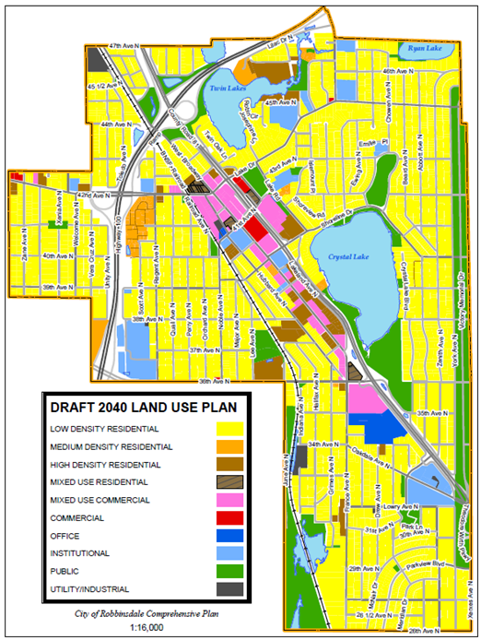

Slide 6
Forecasted Population, Households and Employment by the Metropolitan Council
Forecast Year | Population | Households | Employment
2010 (Census) | 13,953 | 6,032 | 6,858
2020 | 14,750 | 6,300 | 7,000
2030 | 15,100 | 6,600 | 7,100
2040 | 15,300 | 6,800 | 7,200
Forecast Year & Projected Growth | Population | Households | Employment
2010 (Census) | 13,953 | 6,032 | 6,858
April 1, 2015 (Met Council est.) | 14,757 | 6,209 | N/A
2020 (2017-2020) | 14,750 -7* | 6,300 +90 | 7,000 +142
2030 | 15,100 +350 | 6,600 +300 | 7,100 +100
2040 | 15,300 +200 | 6,800 +200 | 7,200 +100
* Estimates only
Minimum community wide densities established in Thrive MSP 2040 | 20 units per acre
Density expectations for fixed or dedicated rights-of-way transitway station area (area within 10-minute walk or ½ mile area) | Minimum 50 units per acre Target: 75-150+ units per acre

Slide 7
The Comprehensive Plan is intended to identify policies that guide the future development of land.
The following sites are being presented as possible locations for redevelopment.
No development related applications have been received and the affected property owners have ultimate discretion whether to sell their property for development, or to become a partner in a development.
In most cases, the examples are made up of multiple properties with multiple property owners that may be a challenge for anyone trying to assemble a site for a development project.
With the regional growth projections in mind, the challenge is to imagine properties that may redevelop and accommodate the increase of population, households (and employment) that are identified for Robbinsdale by the Metropolitan Council.

Slide 8
Opportunity Sites within Robbinsdale
Opportunity Site Criteria
Proximity and walkability to the proposed LRT station.
Existing land use
Underestimated property (parking lots, storage facilities, etc.)
Market rates and trends.
Suitability for transit oriented uses such as mixed-use and multi-family residential.

Slide 9
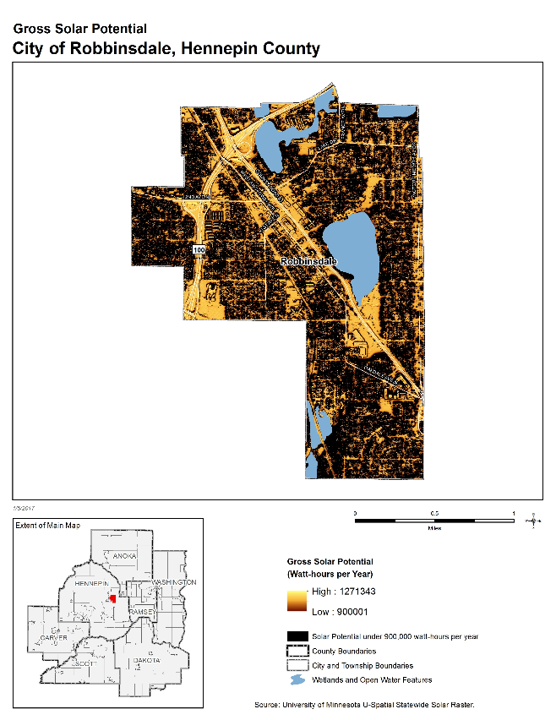
Robbinsdale Gross Solar Potential

Slide 10
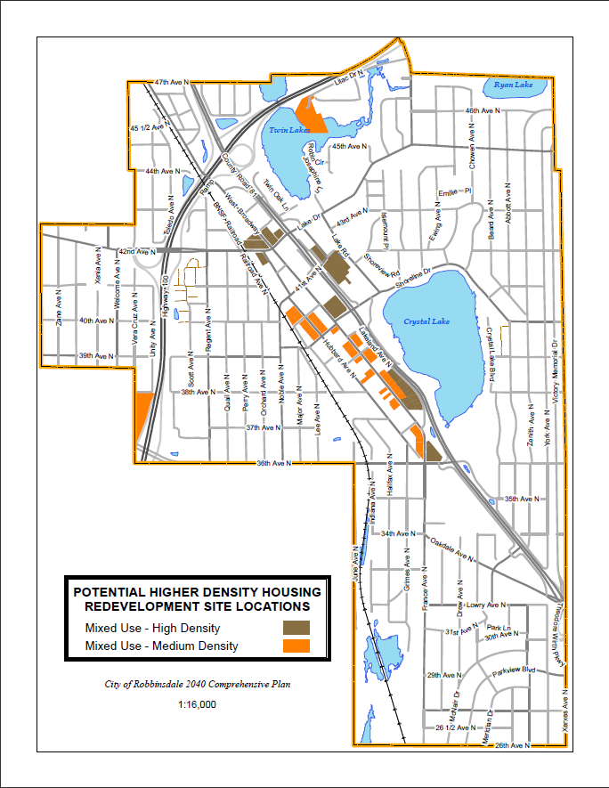
Potential Higher Density Housing Redevelopment Site Locations

