Slide 1
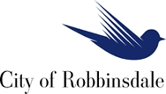
2040 Comprehensive Plan Open House
City of Robbinsdale, Minnesota

Slide 2
Where do you see Robbinsdale in the year 2040?

Slide 3
Components of the Comprehensive Plan
Land Use
Parks, Recreation, Trail and Open Space
Housing
Economic Competitiveness
Transportation
Resilience
Water Resources and other infrastructure
Implementation

Slide 4
Robbinsdale is designated as an “Urban Center”.
Robbinsdale’s location relative to the metro area has caused the Metropolitan Council to designate it as an “Urban Center.” This designation carries expectations for overall densities relative to the forecasts.

Slide 5
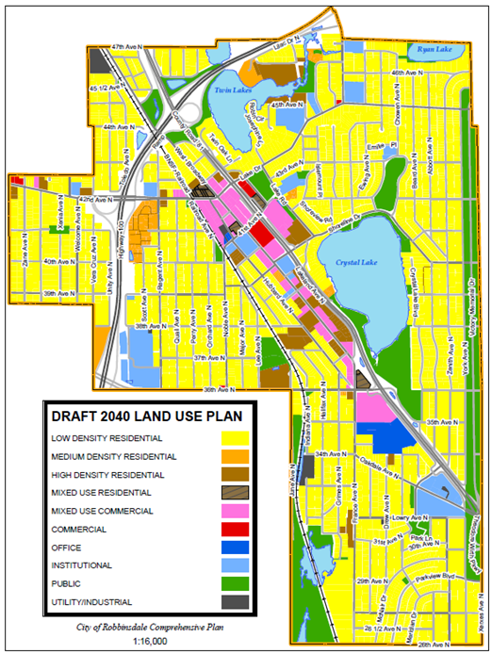

Slide 6
Forecasted Population, Households and Employment by the Metropolitan Council
Forecast Year | Population | Households | Employment
2010 (Census) | 13,953 | 6,032 | 6,858
2020 | 14,750 | 6,300 | 7,000
2030 | 15,100 | 6,600 | 7,100
2040 | 15,300 | 6,800 | 7,200
Forecast Year & Projected Growth | Population | Households | Employment
2010 (Census) | 13,953 | 6,032 | 6,858
April 1, 2015 (Met Council est.) | 14,757 | 6,209 | N/A
2020 (2017-2020) | 14,750 -7* | 6,300 +90 | 7,000 +142
2030 | 15,100 +350 | 6,600 +300 | 7,100 +100
2040 | 15,300 +200 | 6,800 +200 | 7,200 +100
* Estimates only
Minimum community wide densities established in Thrive MSP 2040 | 20 units per acre
Density expectations for fixed or dedicated rights-of-way transitway station area (area within 10-minute walk or ½ mile area) | Minimum 50 units per acre Target: 75-150+ units per acre

Slide 7
The Comprehensive Plan is intended to identify policies that guide the future development of land.
The following sites are being presented as possible locations for redevelopment.
No development related applications have been received and the affected property owners have ultimate discretion whether to sell their property for development, or to become a partner in a development.
In most cases, the examples are made up of multiple properties with multiple property owners that may be a challenge for anyone trying to assemble a site for a development project.
With the regional growth projections in mind, the challenge is to imagine properties that may redevelop and accommodate the increase of population, households (and employment) that are identified for Robbinsdale by the Metropolitan Council.

Slide 8
Opportunity Sites within Robbinsdale
Opportunity Site Criteria
Proximity and walkability to the proposed LRT station.
Existing land use
Underestimated property (parking lots, storage facilities, etc.)
Market rates and trends.
Suitability for transit oriented uses such as mixed-use and multi-family residential.

Slide 9
Legion/St. Petersburg Site
This 1.7 acre site of which 1.55 acres has been on the commercial market for some time. The Robbinsdale Economic Development Authority owns a 0.14 acre parcel that aligns with the northerly driveway to France Ave. N. This site has been previously discussed as a possible high density redevelopment site.
The combined site could accommodate as many as 80-85 multiple family units, if redeveloped similar to Broadway Court. Green space requirements would require slightly more than ½ an acre to achieve that kind of density which could be problematic.
The proximity of Lakeview Terrace Park and the Crystal Lake Regional Trail in addition to the available views would provide off-site amenities which could be taken into consideration.
Redevelopment may be expected to occur within the next 2-5 years.

Slide 10
Lakeland Avenue area north of Citizens Independent Bank
If 6 properties north of Citizen’s Bank were assembled into a 1.87 acre site, as many as 90 to 100 multiple family dwelling units could be created, again, following the example of Broadway Court. As above, useable open space standards would require about 2/3 of an acre.
Acquiring 6 additional sites along the Lakeland Ave. N. frontage road could create as much as 4 acres, allowing for as many as 200 multiple family dwelling units. The single-family homes on Lakeland Ave. N. are zoned B-2, Limited business suggesting that they could become businesses.
Redevelopment may be expected to occur in the next 2-10 years

Slide 11
“Sawhorse” site within the ½ mile of the proposed LRT station
This site would require assembly of multiple properties with at least four businesses including a gas station and funeral chapel.
If the entire site extending from the railroad corridor to West Broadway is considered, approximately 2 acres would be possible.
As many as 90-110 multiple family dwelling units could be available, again, following the example of Broadway Court. Again, useable open space standards would also have to be considered.
Redevelopment may be expected to occur in the next 3-10 years if the Blue Line Extension LRT is funded and built. Otherwise, redevelopment would only occur if supported by market forces.

Slide 12
Parking Ramp “Wrap”
The anticipated parking ramp serving the Blue Line Extension LRT station is proposed to have buildings lining the outer edge of the ramp on two sides. These buildings may be integrated with the ramp or separate.
Commercial uses are being considered, but, high density residential could be an alternative use or the domination portion of a mixed use.
If residential uses are included, they will likely be “single loaded” much like a row house or condo/apartments forming the outer edges of the site perhaps with vehicular access on the ramp side and pedestrian access to the street, or secure access through the ramp.
Development is dependent on the funding and construction of the Blue Line Extension LRT which could occur in the next 3-5 years.
The concept shown above shows residential in pink (upper levels) and commercial in orange (street level)

Slide 13
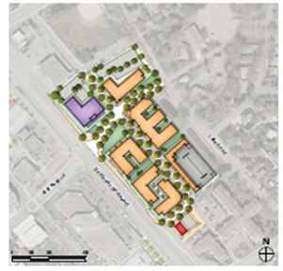
Robin Center – within ½ mile of the proposed LRT station
There are no immediate expectations of the properties that make up Robin Center redeveloping. However, when conditions favor redevelopment, there is the following potential:
“Upper Robin Center” consists of 1.14 acres and includes a portion of the Lakeland Ave. N. frontage road. Approximately 50-70 dwelling units might be possible. Ideally, the upper portion of a mixed use development.
“Lower Robin Center” is much larger at 4.22 acres excluding the Post Office and Car X auto repair. As many as 200-265 dwelling units might be possible.
Redevelopment may occur 2020-2030

Slide 14
Lakeside Office Park
Currently occupied by medical, dental clinics and offices. This property has high amenities but limited access via a narrow 0.3 mile local street and surrounding flood plain.
Medium density residential is recommended. Approximately 4 acres is above the 100 year flood elevation.
30-60 dwelling units are possible.
Redevelopment may occur in the next 5-10 years.

